Slide 1

A Major Project On ORGAN DONATION DECENTRALIZED APPLICATION BACHELOR OF TECHNOLOGY In COMPUTER SCIENCE AND ENGINEERING By SAI SINDHU DANDIBHATLA (197R1A05K4) VANGMAI KOHEDA (197R1A05P9) GAURAV MANDAL (197R1A05L1) Under the Guidance of V. NARESH KUMAR Assistant Professor

Slide 2
ABSTRACT
Organ donation being the most noble deed requires revolutionization. One cannot imagine the urgency and desperation a person feels when his/her family or friends are in need of such act and they could not locate an appropriate donor.
The Proposed System is a web-based Application which uses FIFO approach to select an organ donor for each genuine patient requiring a transplant and if there is an emergency case then the priority is given to that patient.
It provides an efficient platform for potential organ doners and those who need the organs to connect. It uses Blockchain as its underlying Technology.
Blockchain Technology uses digital documents which are digitally signed by the user so that they are timestamped at the time of saving the document and cannot be changed after that. It solves the issue of authenticating the same user again and again.

Slide 3
EXISTING SYSTEM
The problem faced by organ donation systems around the world is the same, more people on the waiting list than actual donors, and the gap is widening each year. The length of the waiting list may mean patients die before donation takes place.
These systems are rarely up to-date with the minimum-security requirements, and with improvements in modern computer processing power and algorithms, it is best to take a cautious approach to avoid future complications.
Recently there has been an increase in security breaches, compromising user privacy and the integrity of the system.
Modern systems handle and manage data via traditional databases, however most hospitals, health ministries and other medical facilities do not have a uniform system for communicating data.

Slide 4
DISADVANTAGES
Modern systems responsible for gathering organ donations and handling processes leading up to organ transplantations can lack transparency.
They are also usually slow, which is intolerable in such a serious, life threatening matter.
The existing systems are not secured.
These systems are usually not maintained from time to time.

Slide 5
PROPOSED SYSTEM
We are presenting a secure method of organ donation over a decentralized platform.
This system will be implemented via a web portal that connects organ donors with receivers and the system will be administered by hospitals.
We are trying to completely avoid third-party interference and protecting the integrity of the patient data and identification of the donated organs. This will be attained with the help of smart contracts.
All transaction-related information and patient data will be bundled into a smart contract and pushed into the blockchain.
We also aim at tracking the location of the organ, during its transfer, with the help of an QR Code.

Slide 6
ADVANTAGES
It creates a decentralized and distributed system, meaning no node in the system has overall authority.
Blockchain is a permanent ledger, so any unauthorized alteration will not go unnoticed.
Transactional processing is blockchain supported while being cost effective, which is convenient for non-profit projects.
It is a quick and precise method that rejects malicious activities and exploitation attempts.
Blockchain increases the speed of the organ donation process.

Slide 7
HARDWARE REQUIRMENTS
Processor: Intel Celeron or higher, AMD Ryzen 3 2500U and above
• RAM: 4GB and above
• Space on Hard Disk: minimum 5GB

Slide 8
SOFTWARE REQUIRMENTS
For Web Development:
HTML CSS
MySQL – Database Python 3.7 and above
Django – Web Based Framework
Block chain:
Ethereum - Block chain Network
Solidity - Smart Contracts
Ganache - Create private Ethereal block chain to run test
Meta Mask- For Interaction with Ethereum

Slide 9
NOVELTY
The initiated system is an organ donation decentralized app using blockchain technology, which is a web application for patients to register their information like most medical ID, blood type, organ type and state.
The system would work on a first-in, first-out basis. Blockchain technology is used to secure the information of the organ donors and store them in a distributed database.
Our system is a more secured approach, and it provides efficient automation than current approaches.
It is much faster improving the scalability of the system.
It is therefore impossible to falsify a block or add other false information without the approval of all authorized parties being involved

Slide 10
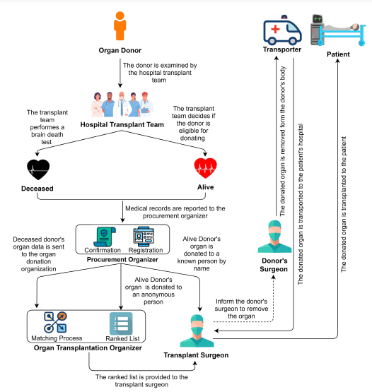
ARCHITECTURE

Slide 11
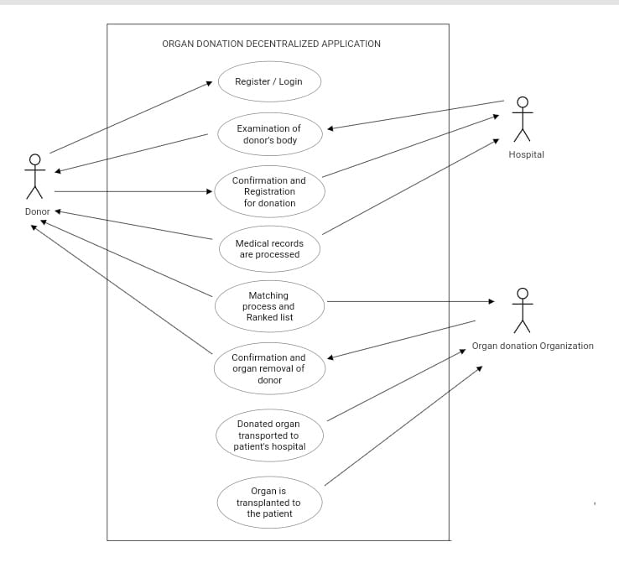
USE CASE DIAGRAM

Slide 12
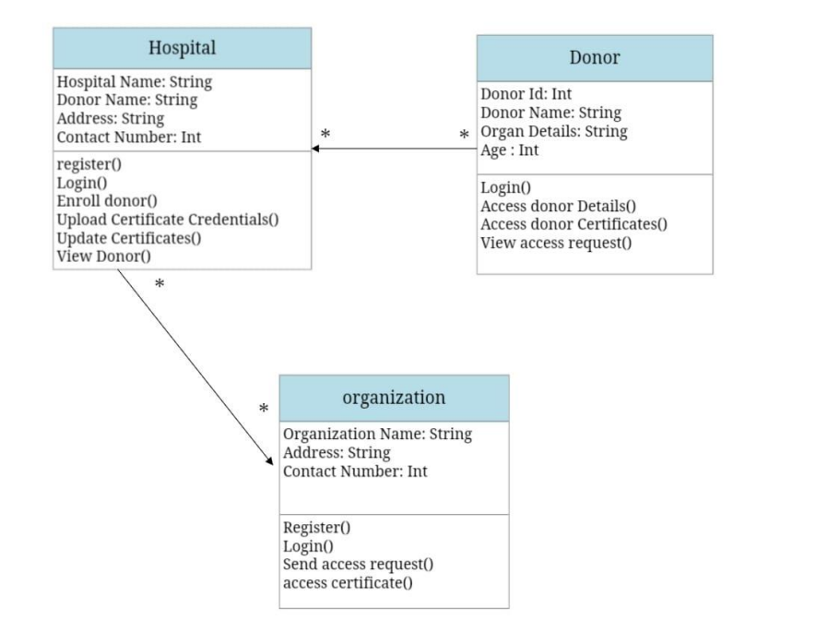
CLASS DIAGRAM

Slide 13
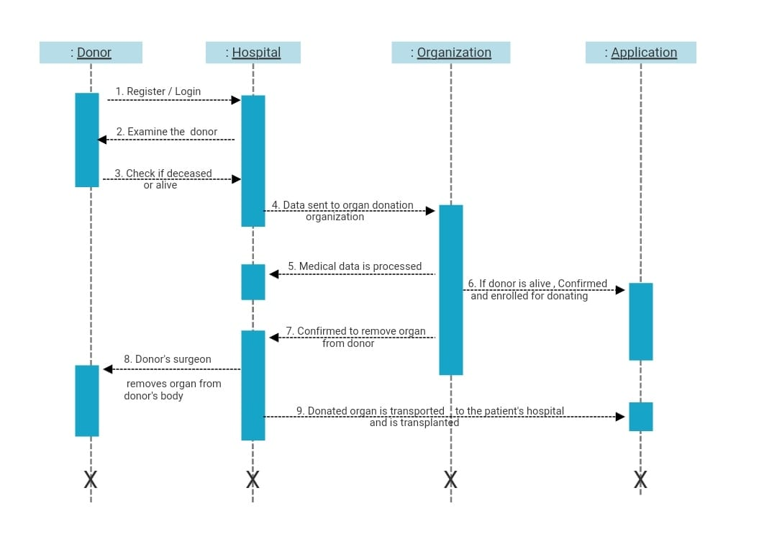
SEQUENCE DIAGRAM

Slide 14
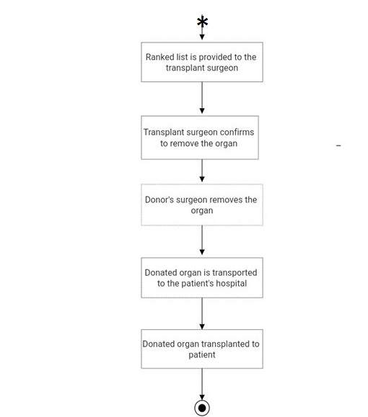
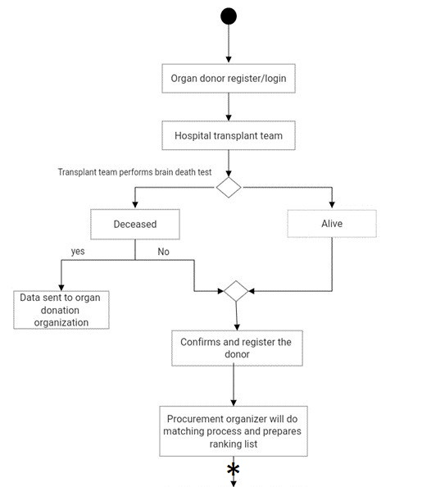
ACTIVITY DIAGRAM

Slide 15
SAMPLE CODE
#!/usr/bin/env python
import os
import sys
if __name__ == '__main__':
os.environ.setdefault('DJANGO_SETTINGS_MODULE', 'userCredential.settings')
try:
from django.core.management import execute_from_command_line
except ImportError as exc:
raise ImportError(
"Couldn't import Django. Are you sure it's installed and "
"available on your PYTHONPATH environment variable? Did you "
"forget to activate a virtual environment?"
) from exc
execute_from_command_line(sys.argv)

Slide 16
SAMPLE CODE
pragma solidity >= 0.8.11 <= 0.8.11;
contract user {
string public user_data;
string public credential_data;
string public access_request;
string public school_company;
//add school or company details
function addSchoolCompany(string memory d) public {
school_company = d;
}
//get schools or company details
function getSchoolCompany() public view returns (string memory) {
return school_company;
}
function enrolluser(string memory d) public {
user_data = d;
}

Slide 17
SAMPLE CODE
function getuser() public view returns (string memory) {
return user_data;
}
function setCredentialData(string memory d) public {
credential_data = d;
}
function getCredential() public view returns (string memory) {
return credential_data;
}
function setAccessRequest(string memory d) public {
access_request = d;
}
function getAccess() public view returns (string memory) {
return access_request;
}
constructor() public {
user_data = "";
credential_data="";
access_request="";
school_company="";
}
}

Slide 18
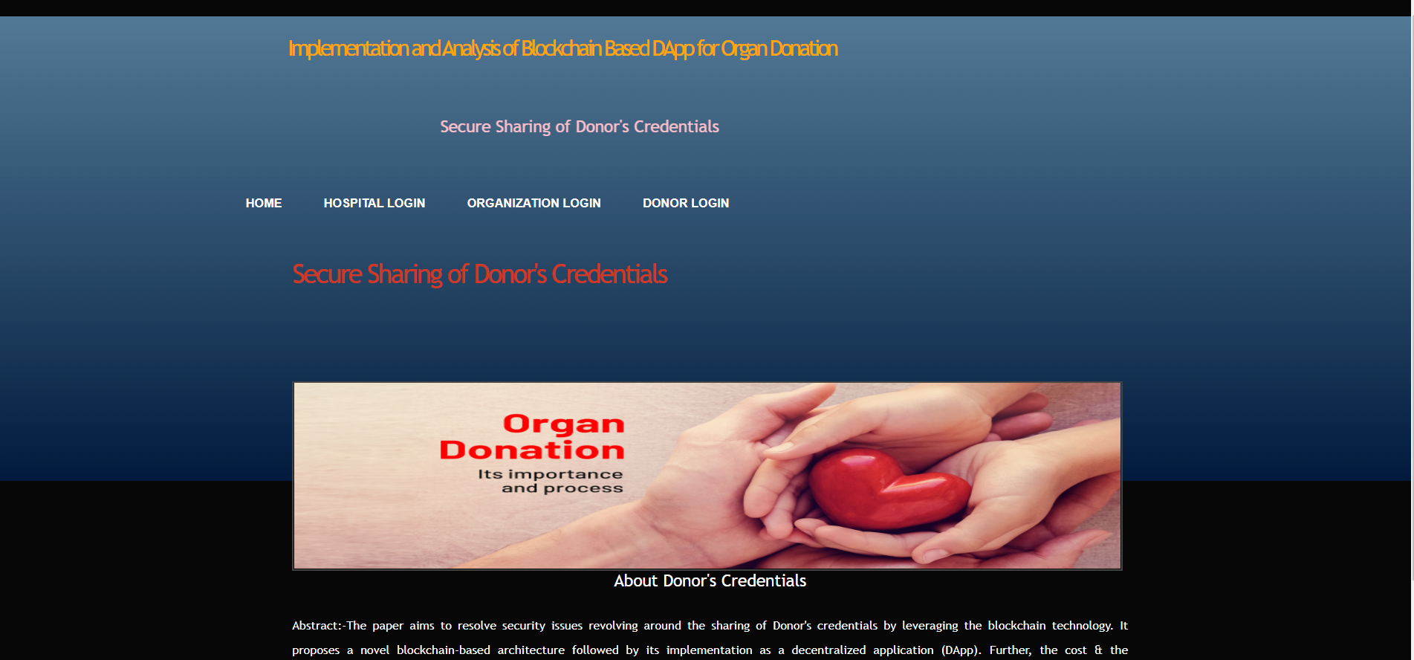
SCREENSHOTS

Slide 19
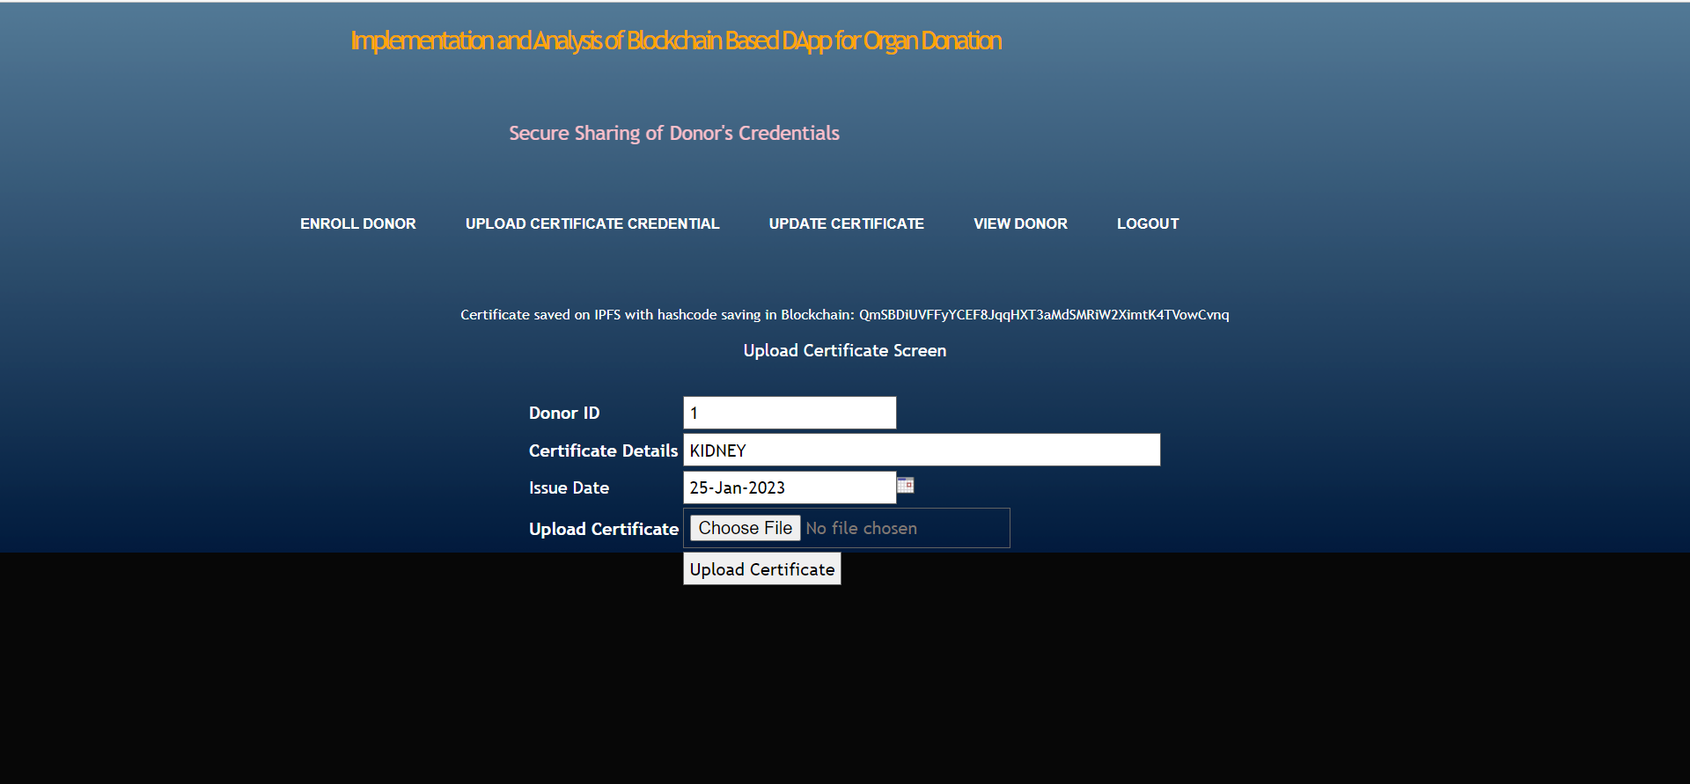
SCREENSHOTS

Slide 20
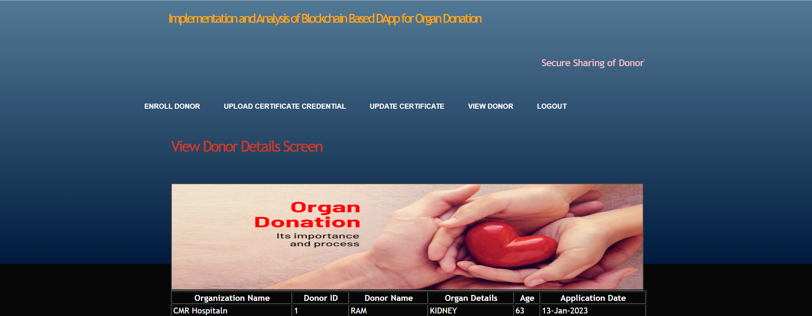
SCREENSHOTS

Slide 21
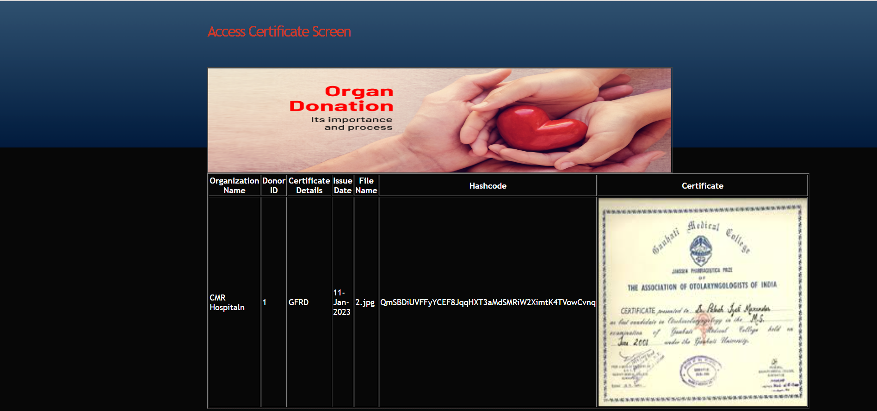
SCREENSHOTS

Slide 22
CONCLUSION
The proposed system is designed to meet the Standards set by the health authorities, but with a decentralized take on the current system used, with the use of blockchain technology.
So, we concluded that our system is better security wise, and it provides automation than current systems.
A much faster system with improves scalability that can handle increased growth in the amount of work.
Transparency in increased, and corruption is almost impossible to occur.

Slide 23
FUTURE ENHANCEMENT
The initiated system is an organ donation decentralized app using blockchain technology, which is a web application for patients to register their information like most medical ID, blood type, organ type and state.
The system would work on a first-in, firstout basis. Blockchain technology is used to secure the information of the organ donors and store them in a distributed database.
Our system is a more secured approach, and it provides efficient automation than current approaches.
It is much faster improving the scalability of the system. It is therefore impossible to falsify a block or add other false information without the approval of all authorized parties being involved.

Slide 24
REFERENCES
[1] L. A. Dajim, S. A. Al-Farras, B. S. Al-Shahrani, A. A. Al-Zuraib, and R. Merlin Mathew, ‘‘Organ donation decentralized application using blockchain technology,’’ in Proc. 2nd Int. Conf. Comput. Appl. Inf. Secur. (ICCAIS), May 2019, pp. 1–4, doi: 10.1109/cais.2019.8769459.
[2] A. Powell. (Mar. 18, 2019). A Transplant Makes History. Harvard Gazette. [Online]. Available: https://news.harvard.edu/gazette/story/2011/09/atransplant-makes-history/
[3] (Mar. 21, 2019). Facts and Myths About Transplant. Accessed: Apr. 21, 2021. [Online]. Available: https://www.americantransplant foundation.org/abouttransplant/facts-and-myths/
[4] Organ Procurement and Transplantation Network. Accessed: Apr. 18, 2021. [Online]. Available: https://optn.transplant.hrsa.gov/ resources/ethics/ethical-principles-in-theallocation-of-humanorgans/

Slide 25
GITHUB LINK
https://github.com/gauravmandal27/OrganDonationDApp

Slide 26
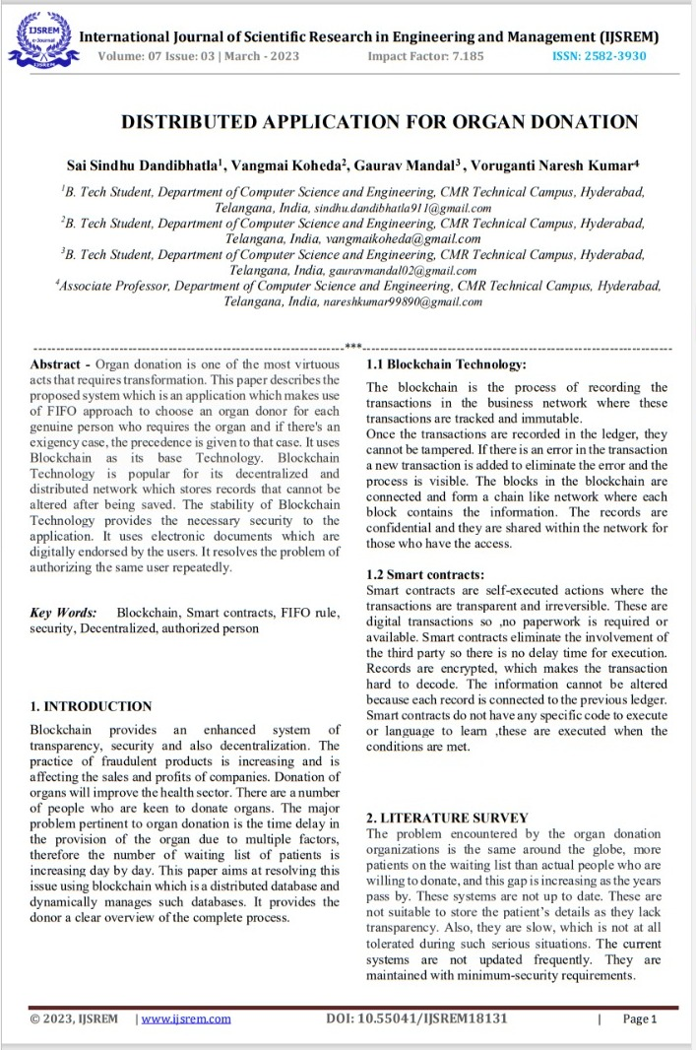
PAPER PUBLICATION

Slide 27
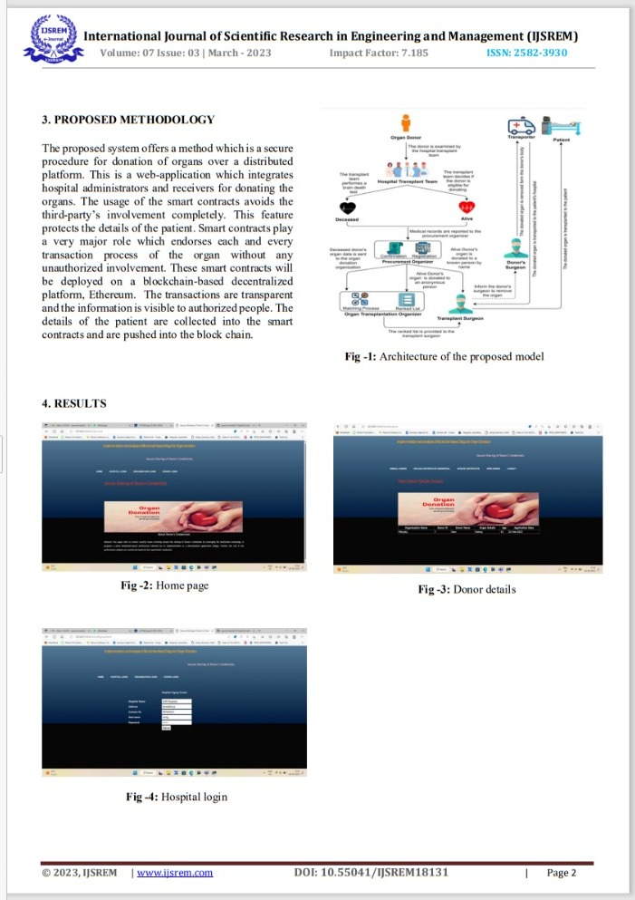
PAPER PUBLICATION

Slide 28
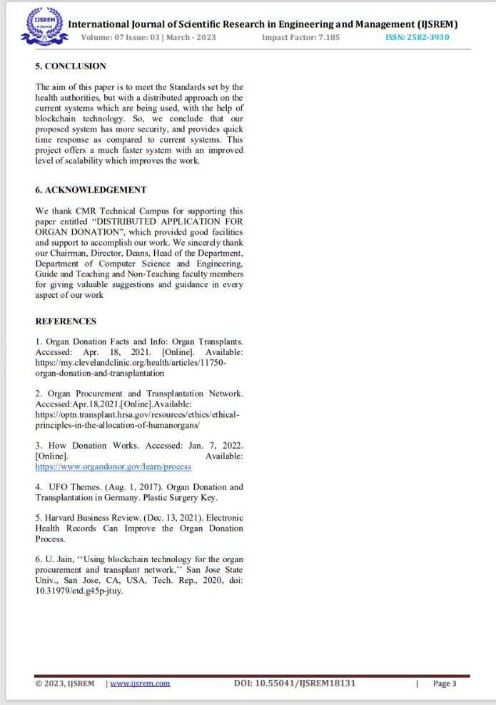
PAPER PUBLICATION

Slide 29
THANK YOU

